Slide 1
4
INTEGRALS

Slide 2
4.2
The Definite Integral

Slide 3
The Definite Integral
We saw that a limit of the form
arises when we compute an area. We also saw that it arises when we try to find the distance traveled by an object. It turns out that this same type of limit occurs in a wide variety of situations even when f is not necessarily a positive function.
Here we consider limits similar to [1] but in which f need not be positive or continuous and subintervals don’t necessarily have the same length.

Slide 4
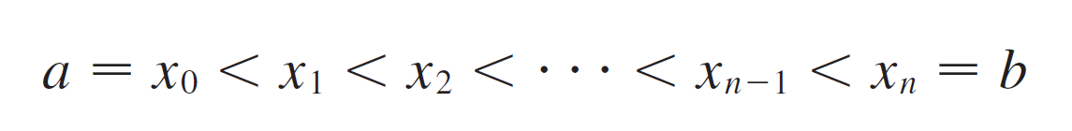
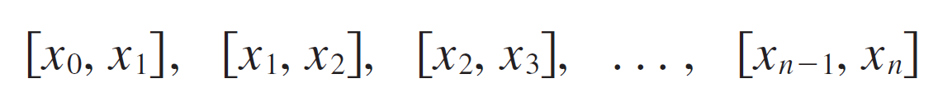
The Definite Integral
In general, we start with any function f defined on [a, b] and we divide [a, b] into n smaller subintervals by choosing partition points x₀, x₁, x₂ ,…, x_{n} so that
The resulting collection of subintervals
is called a partition P of [a, b].

Slide 5
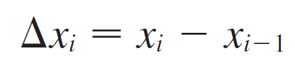


The Definite Integral
We use the notation Δx_{i} for the length of the i th subinterval [x_{i –1}, x_{i}].
Thus
Then we choose sample points in the subintervals with in the ith subinterval [x_{i –1}, x_{i}].
These sample points could be left endpoints or right endpoints or any numbers between the endpoints.

Slide 6
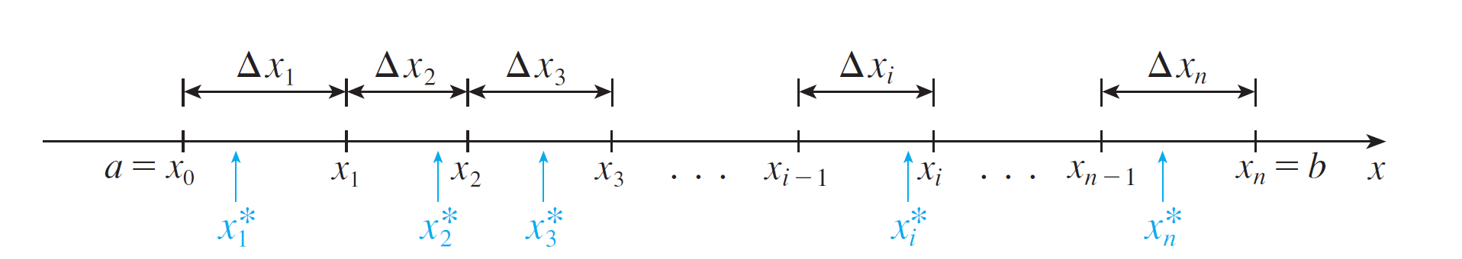

The Definite Integral
Figure 1 shows an example of a partition and sample points.
A partition of [a, b] with sample points
Figure 1

Slide 7
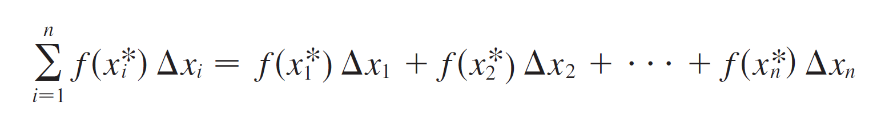
The Definite Integral
A Riemann sum associated with a partition P and a function f is constructed by evaluating f at the sample points, multiplying by the lengths of the corresponding subintervals, and adding:

Slide 8
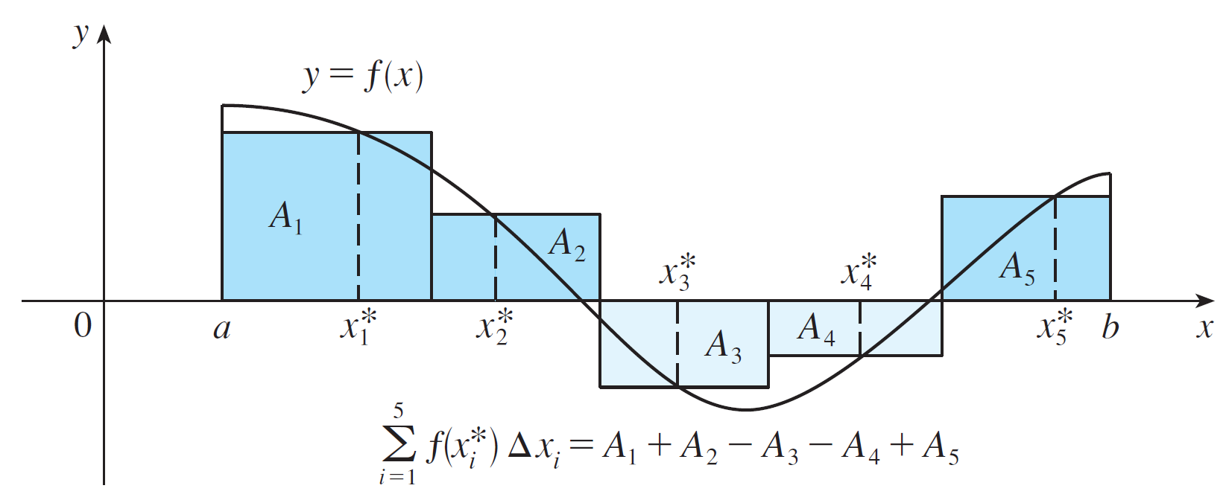
The Definite Integral
The geometric interpretation of a Riemann sum is shown in Figure 2.
A Riemann sum is the sum of the areas of the rectangles above the x-axis and the negatives of the areas of the rectangles below the x-axis.
Figure 2

Slide 9


The Definite Integral
Notice that if is negative, then is negative and so we have to subtract the area of the corresponding rectangle.
If we imagine all possible partitions of [a, b] and all possible choices of sample points, we can think of taking the limit of all possible Riemann sums as n becomes large by analogy with the definition of area.
But because we are now allowing subintervals with different lengths, we need to ensure that all of these lengths Δx_{i} approach 0.

Slide 10
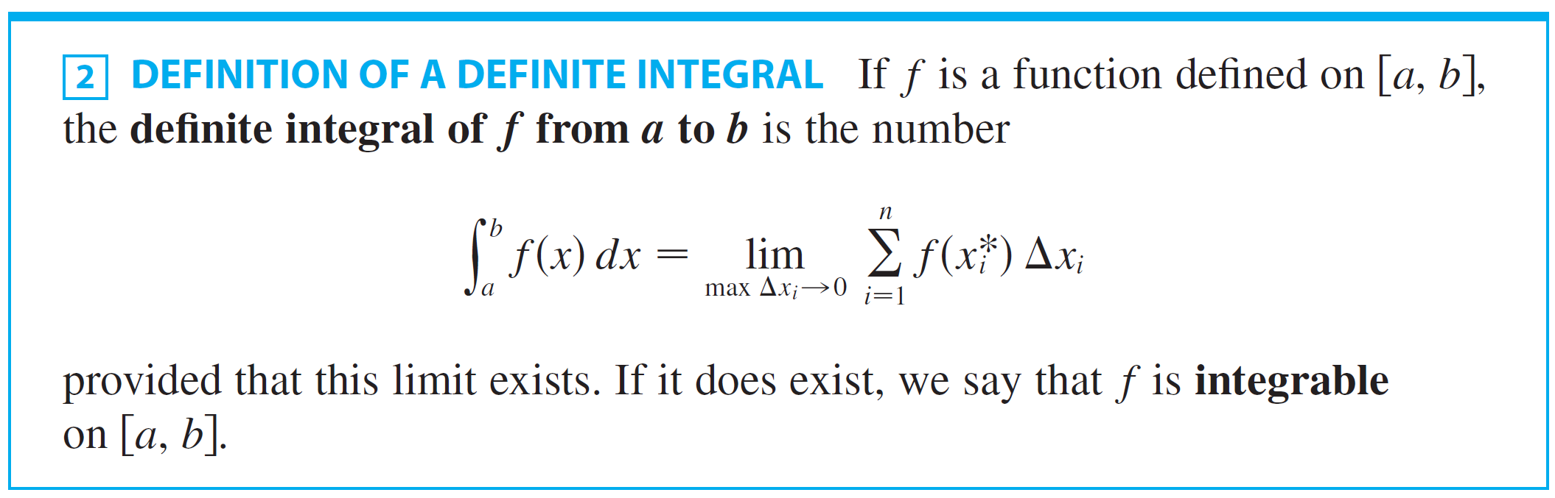
The Definite Integral
We can do that by insisting that the largest of these lengths, which we denote by max Δx_{i}, approaches 0.
The result is called the definite integral of f from a to b.

Slide 11
DEFINITE INTEGRAL
The precise meaning of the limit that defines the integral in Definition 2 is as follows:
It means that for every number ε > 0 there is a corresponding number δ > 0 such that for all partitions P of [a, b] with max Δx_{i} < δ and for all possible choices of x_{i}* in [x_{i – 1}, x_{i}].

Slide 12
DEFINITE INTEGRAL
This means that a definite integral can be approximated to within any desired degree of accuracy by a Riemann sum.

Slide 13

The Definite Integral
NOTE 1: The symbol ∫ was introduced by Leibniz and is called an integral sign.
It is an elongated S and was chosen because an integral is a limit of sums.
In the notation is called the integrand and a and b are called the limits of integration; a is the lower limit and b is the upper limit.

Slide 14



The Definite Integral
For now, the symbol dx has no official meaning by itself; is all one symbol.
The dx simply indicates that the independent variable is x. The procedure of calculating an integral is called integration.
NOTE 2: The definite integral is a number; it does not depend on x. In fact, we can use any letter in place of x without changing the value of the integral:

Slide 15
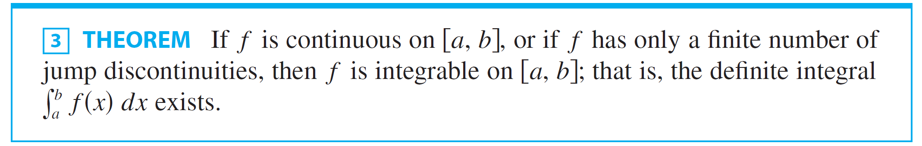
The Definite Integral
We have defined the definite integral for an integrable function, but not all functions are integrable. The following theorem shows that the most commonly occurring functions are in fact integrable.

Slide 16



The Definite Integral
If f is integrable on [a, b], then the Riemann sums in Definition 2 must approach as max no matter how the partitions and sample points are chosen.
So in calculating the value of an integral we are free to choose partitions P and sample points to simplify the calculation.
It’s often convenient to take P to be a regular partition; that is, all the subintervals have the same length Δx.

Slide 17
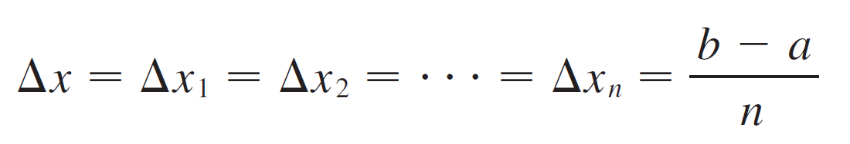
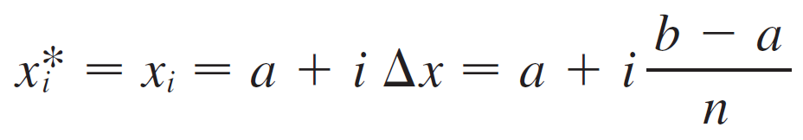
The Definite Integral
Then
and
If we choose to be the right endpoint of the i th subinterval, then

Slide 18


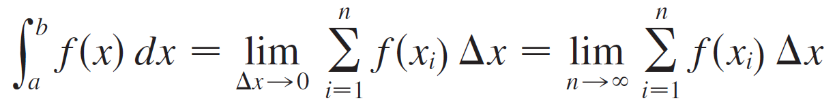
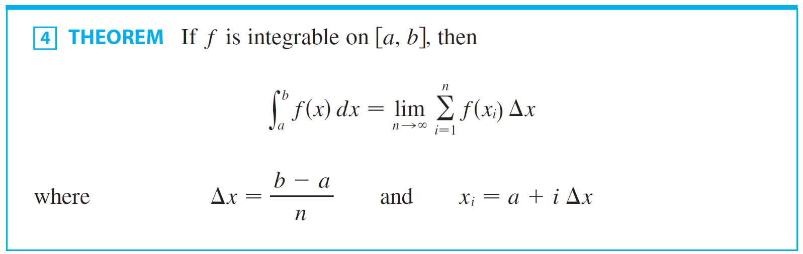
The Definite Integral
In this case, max as , so Definition 2 gives
In computing the value of an integral, Theorem 4 is much easier to use than Definition 2.

Slide 19
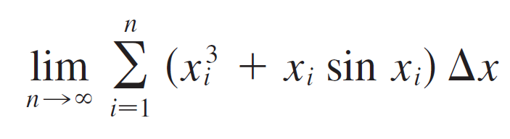
Example 1
Express
as an integral on the interval [0, π ].

Slide 20

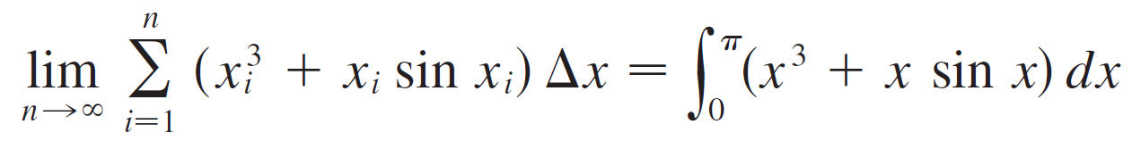
Example 1- Solution
SOLUTION:
Comparing the given limit with the limit in Theorem 4, we see that they will be identical if we choose .
We are given that a = 0 and b = π.
Therefore, by Theorem 4, we have

Slide 21
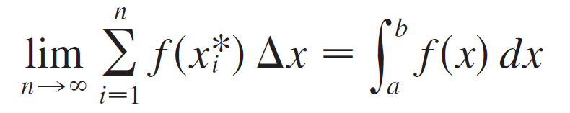
The Definite Integral
In general, when we write
we replace lim Σ by ∫, by x, and Δx by dx.

Slide 22
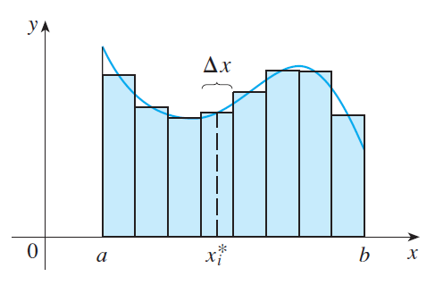

The Definite Integral
NOTE 3: If f happens to be positive, then the Riemann sum can be interpreted as a sum of areas of approximating rectangles (see Figure 3).
Figure 3

Slide 23

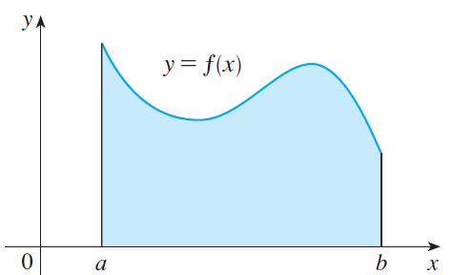

The Definite Integral
By comparing Theorem 4 with the definition of area in Section 4.1, we see that the definite integral
can be interpreted as the area under the curve y= f (x) from a to b. (See Figure 4.)
Figure 4

Slide 24
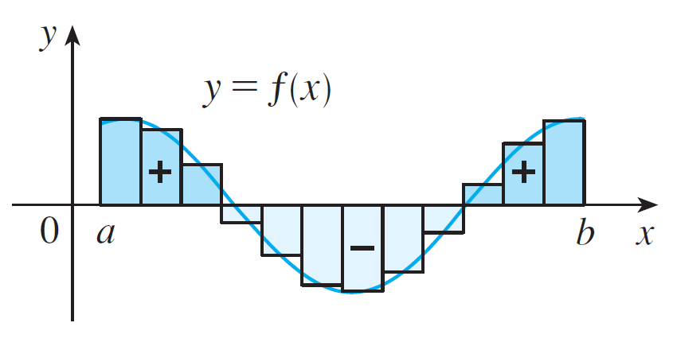

The Definite Integral
If f takes on both positive and negative values, as in Figure 5, then the Riemann sum is the sum of the areas of the rectangles that lie above the x-axis and the negatives of the areas of the rectangles that lie below the x-axis (the areas of the dark blue rectangles minus the areas of the light blue rectangles).
is an approximation to the net area.
Figure 5

Slide 25
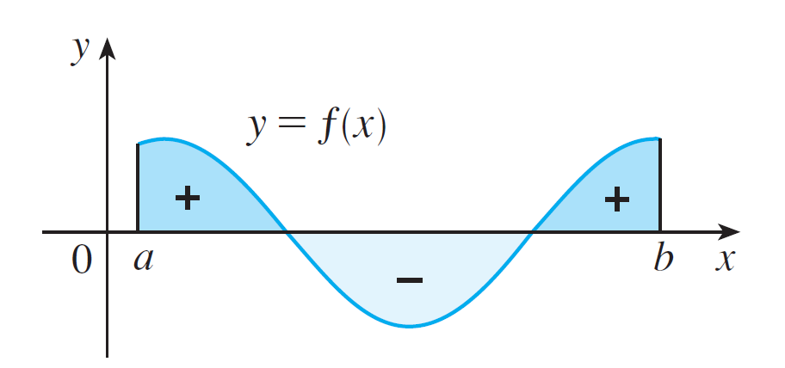
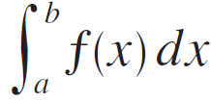
The Definite Integral
When we take the limit of such Riemann sums, we get the situation illustrated in Figure 6.
is the net area.
Figure 6

Slide 26
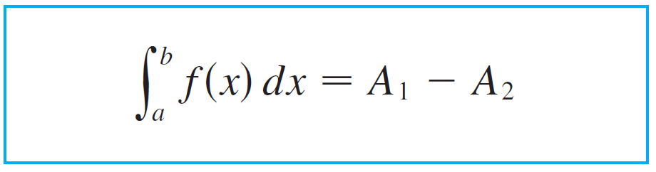
The Definite Integral
A definite integral can be interpreted as a net area, that is, a difference of areas:
where A₁ is the area of the region above the x-axis and below the graph of f, and A₂ is the area of the region below the x–axis and above the graph of f.

Slide 27
Evaluating Integrals

Slide 28
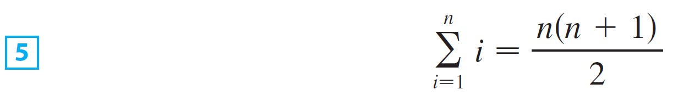
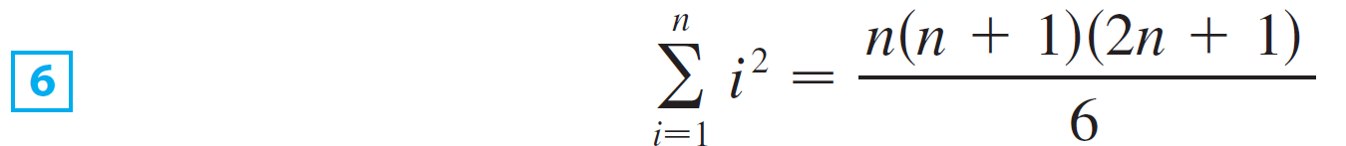
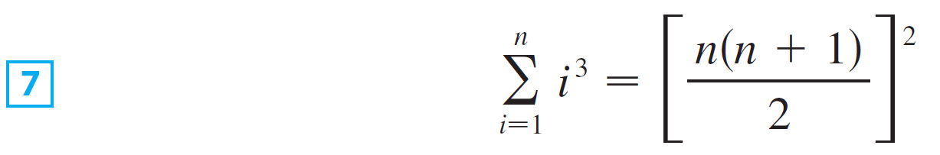
Evaluating Integrals
The following three equations give formulas for sums of powers of positive integers.

Slide 29
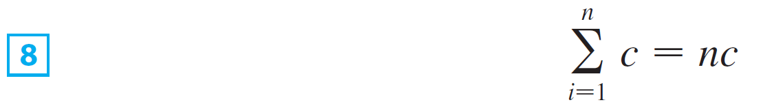
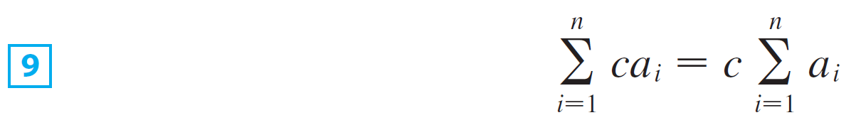
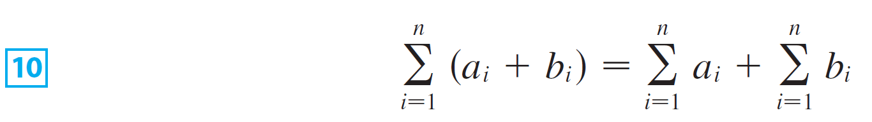
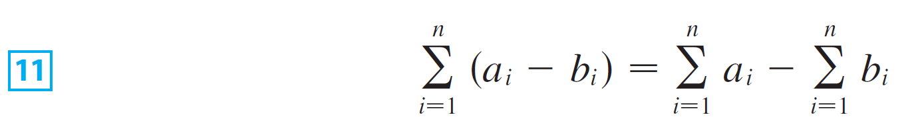
Evaluating Integrals
The remaining formulas are simple rules for working with sigma notation:

Slide 30
Example 2
(a)Evaluate the Riemann sum for f(x) = x³ – 6x taking the sample points to be right endpoints and a = 0, b = 3, and n = 6.
(b)Evaluate

Slide 31
Example 2(a) SOLUTION
With n = 6,
The interval width is:
The right endpoints are: x₁ = 0.5, x₂ = 1.0, x₃ = 1.5, x₄ = 2.0, x₅ = 2.5, x₆ = 3.0

Slide 32
Example 2(a) SOLUTION
So, the Riemann sum is:

Slide 33
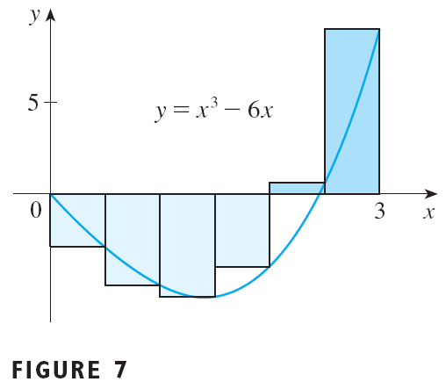
Example 2(a) SOLUTION
Notice that f is not a positive function.
So, the Riemann sum does not represent a sum of areas of rectangles.
However, it does represent the sum of the areas of the gold rectangles (above the x-axis) minus the sum of the areas of the blue rectangles (below the x-axis) in Figure 7.

Slide 34
Example 2(b) SOLUTION
With n subintervals, we have:
Thus, x₀ = 0, x₁ = 3/n, x₂ = 6/n, x₃ = 9/n.
In general, x_{i} = 3i/n.
Since we are using right endpoints, we can use Theorem 4, as follows.

Slide 35
Example 2(b) SOLUTION

Slide 36
Example 2(b) SOLUTION

Slide 37
Example 2(b) SOLUTION
This integral can’t be interpreted as an area because f takes on both positive and negative values.
However, it can be interpreted as the difference of areas A₁ – A₂, where A₁ and A₂ are as shown in Figure 8.

Slide 38
Example 2(b) SOLUTION
Figure 9 illustrates the calculation by showing the positive and negative terms in the right Riemann sum R_{n} for n = 40.

Slide 39
Example 2(b) SOLUTION
The values in the table show the Riemann sums approaching the exact value of the integral, – 6.75, as n → ∞.

Slide 40
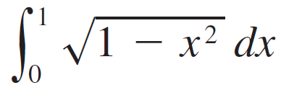
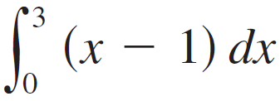
Example 3
Evaluate the following integrals by interpreting each in terms of areas.
(a) (b)

Slide 41




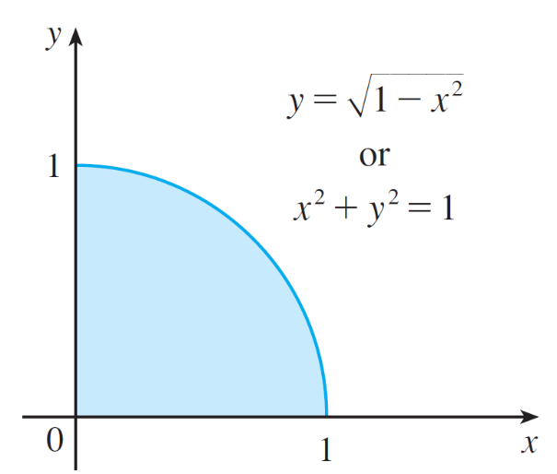
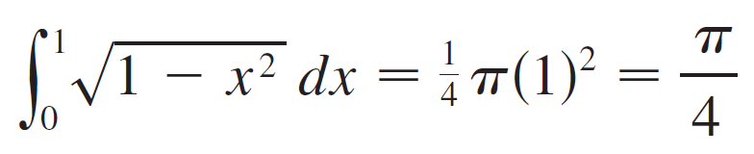
Example 3 - Solution
SOLUTION:
Since , we can interpret this integral as the area under the curve from 0 to 1.
But, since , we get , which shows
that the graph of f is the quarter-circle with radius 1 in
Figure 10.
Therefore,
Figure 10

Slide 42
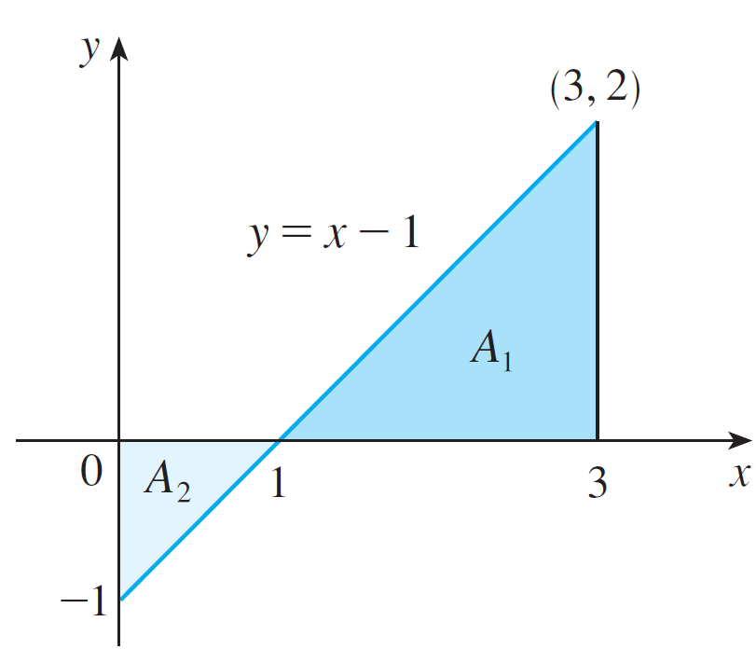
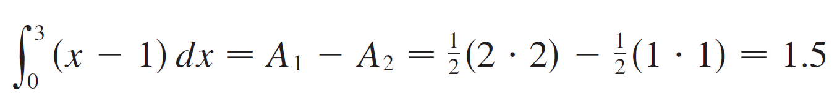
Example 3 – Solution
cont’d
(b) The graph of y = x – 1 is the line with slope 1 shown in Figure 11.
We compute the integral as the difference of the areas of the two triangles:
Figure 11

Slide 43
The Midpoint Rule

Slide 44


The Midpoint Rule
We often choose the sample point to be the right endpoint of the i th subinterval because it is convenient for computing the limit.
But if the purpose is to find an approximation to an integral, it is usually better to choose to be the midpoint of the interval, which we denote by .

Slide 45
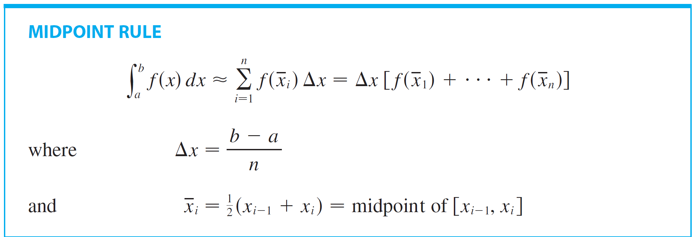
The Midpoint Rule
Any Riemann sum is an approximation to an integral, but if we use midpoints and a regular partition we get the following approximation.

Slide 46
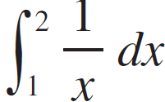
Example 4
Use the Midpoint Rule with n = 5 to approximate .

Slide 47

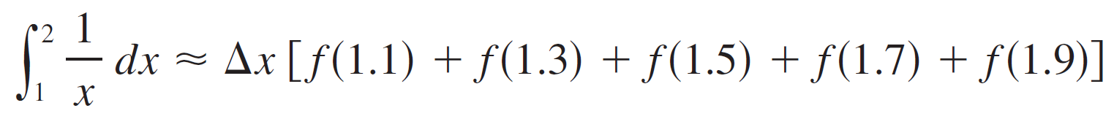
Example 4
SOLUTION:
The endpoints of the five subintervals are 1, 1.2, 1.4, 1.6, 1.8, and 2.0, so the midpoints are 1.1, 1.3, 1.5, 1.7, and 1.9.
The width of the subintervals is
so the Midpoint Rule gives

Slide 48
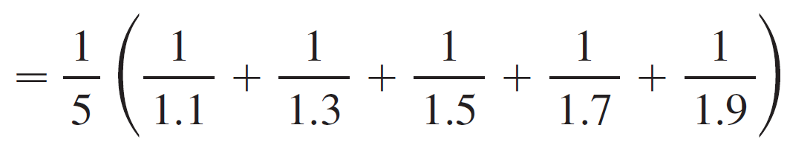
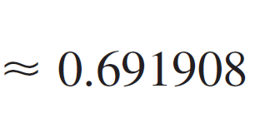
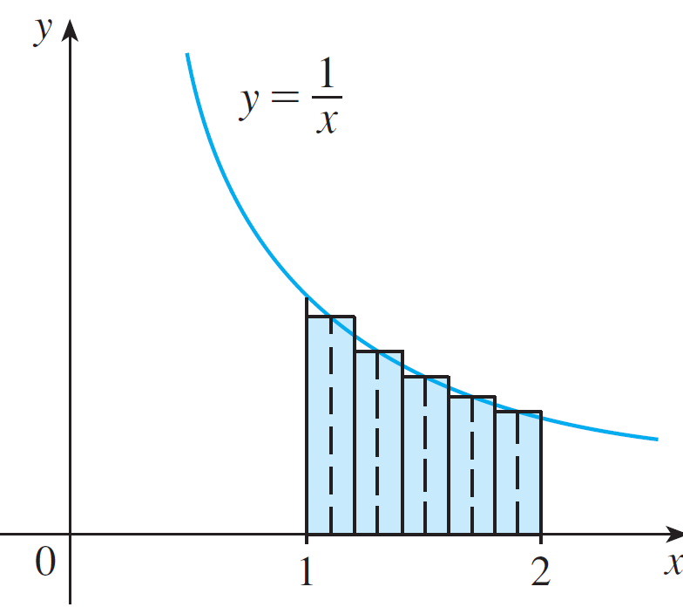
Example 4 – Solution
cont’d
Since f (x) = 1/x > 0 for 1 ≤ x ≤ 2, the integral represents an area, and the approximation given by the Midpoint Rule is the sum of the areas of the rectangles shown in Figure 12.
Figure 12

Slide 49
MIDPOINT RULE
At the moment, we don’t know how accurate the approximation in Example 4 is.
However, in Section 6.7, we will learn a method for estimating the error involved in using the rule.
At that time, we will discuss other methods for approximating definite integrals.

Slide 50
MIDPOINT RULE
If we apply the rule to the integral in Example 2, we get in Figure 13.

Slide 51
MIDPOINT RULE
The approximation M₄₀ ≈ – 6.7563 is much closer to the true value – 6.75 than the right endpoint approximation, R₄₀ ≈ – 6.3998, in Figure 9.

Slide 52
Properties of the Definite Integral

Slide 53

Properties of the Definite Integral
We now develop some basic properties of integrals that will help us to evaluate integrals in a simple manner. We assume that f and g are integrable functions.
When we defined the definite integral , we implicitly assumed that a < b.
But the definition as a limit of Riemann sums makes sense even if a > b.

Slide 54
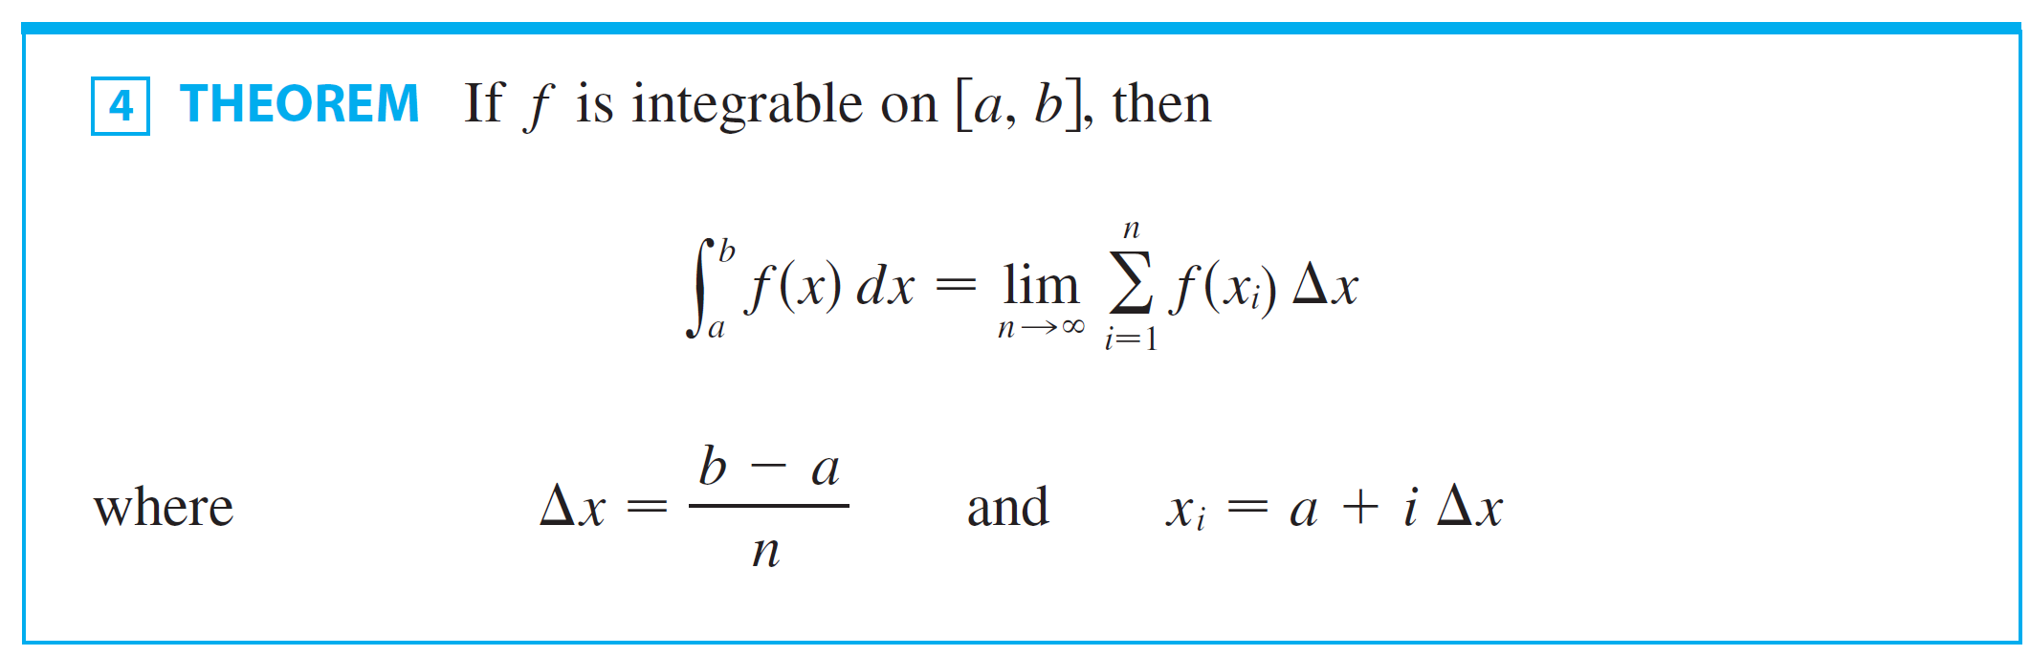
Properties of the Definite Integral
Notice that if we reverse a and b in Theorem 4, then Δx changes from (b – a)/n to (a – b)/n.

Slide 55
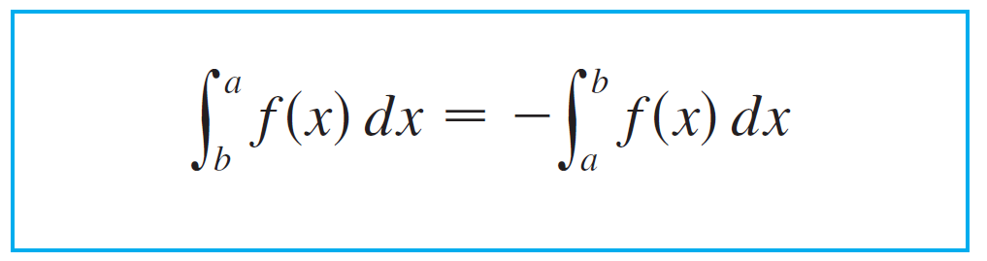

Properties of the Definite Integral
Therefore
If a = b, then Δx = 0 and so

Slide 56
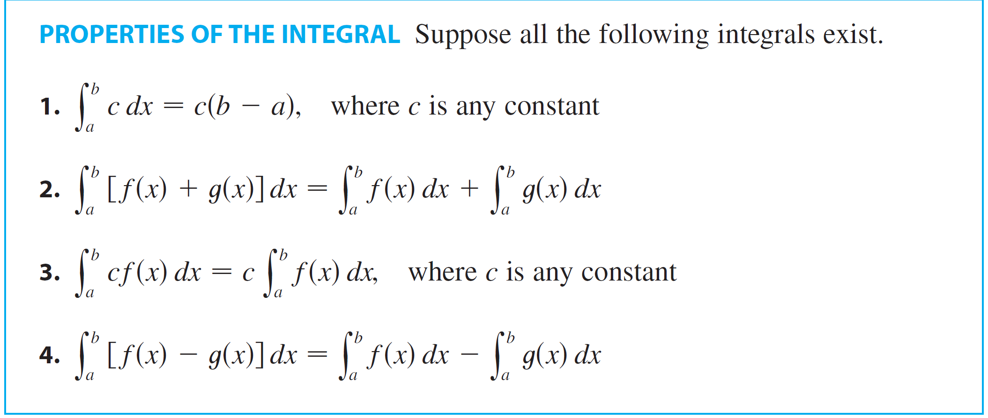
Properties of the Definite Integral

Slide 57
PROPERTY 1
Property 1 says that the integral of a constant function f(x) = c is the constant times the length of the interval.
If c > 0 and a < b, this is to be expected, because c(b – a) is the area of the shaded rectangle here.

Slide 58
PROPERTY 2
Property 2 says that the integral of a sum is the sum of the integrals.
For positive functions, it says that the area under f + g is the area under f plus the area under g.

Slide 59
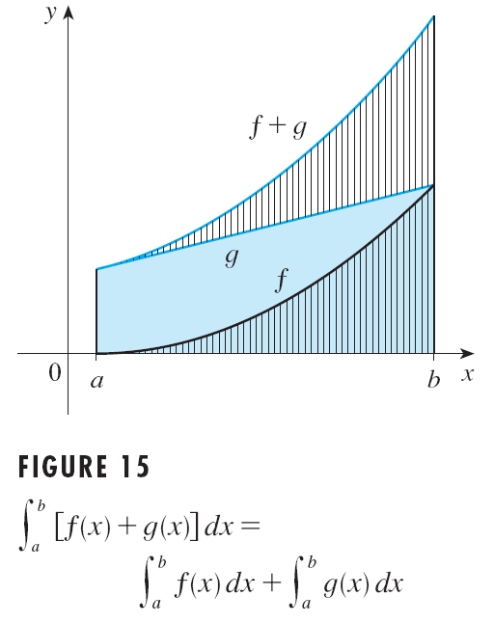
PROPERTY 2
Figure 15 helps us understand why this is true.
In view of how graphical addition works, the corresponding vertical line segments have equal height.

Slide 60
PROPERTY 2
In general, Property 2 follows from Theorem 4 and the fact that the limit of a sum is the sum of the limits:

Slide 61
PROPERTY 3
Property 3 can be proved in a similar manner and says that the integral of a constant times a function is the constant times the integral of the function.
That is, a constant (but only a constant) can be taken in front of an integral sign.

Slide 62
PROPERTY 4
Property 4 is proved by writing f – g = f + (– g) and using Properties 2 and 3 with c = – 1.

Slide 63
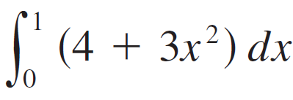
Example 5
Use the properties of integrals to evaluate .

Slide 64
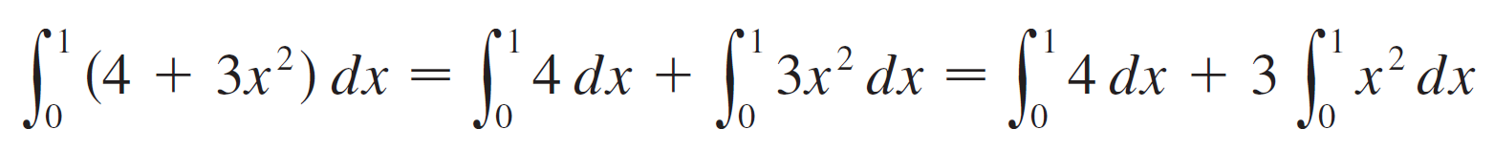
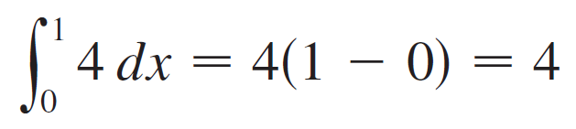
Example 5
SOLUTION:
Using Properties 2 and 3 of integrals, we have
We know from Property 1 that

Slide 65
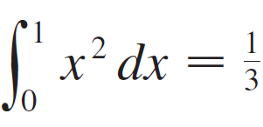
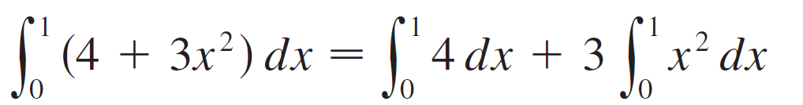


Example 5 – Solution
cont’d
and we found in Section 4.1 that .
So

Slide 66


Properties of the Definite Integral
The next property tells us how to combine integrals of the same function over adjacent intervals:
For the case where f (x) ≥ 0 and a < c < b it can be seen from the geometric interpretation
in Figure 16: The area under
y = f (x) from a to c plus
the area from c to b is
equal to the total area from a to b.
Figure 16

Slide 67



Example 6
If it is known that and ,
find .

Slide 68




Example 6
SOLUTION:
By Property 5, we have
so

Slide 69
Properties of the Definite Integral
Properties 1 – 5 are true whether:
a < b
a = b
a > b

Slide 70

Properties of the Definite Integral
The following properties, in which we compare sizes of functions and sizes of integrals, are true only if a ≤ b.

Slide 71
PROPERTY 6
If f(x) ≥ 0, then represents the area under the graph of f.
Thus, the geometric interpretation of the property is simply that areas are positive.
However, the property can be proved from the definition of an integral.

Slide 72
PROPERTY 7
Property 7 says that a bigger function has a bigger integral.
It follows from Properties 6 and 4 because f – g ≥ 0.

Slide 73
PROPERTY 8
Property 8 is illustrated by Figure 17 for the case where f(x) ≥ 0.

Slide 74
PROPERTY 8
If f is continuous, we could take m and M to be the absolute minimum and maximum values of f on the interval [a, b].

Slide 75
PROPERTY 8
In this case, Property 8 says that:
The area under the graph of f is greater than the area of the rectangle with height m and lessthan the area of the rectangle with height M.

Slide 76
PROPERTY 8—PROOF
Since m ≤ f(x) ≤ M, Property 7 gives:
Using Property 1 to evaluate the integrals on the left and right sides, we obtain:
Property 8 is useful when all we want is a rough estimate of the size of an integral without going to the bother of using the Midpoint Rule.

Slide 77

Example 7
Use Property 8 to estimate

Slide 78



Example 7
SOLUTION:
Since is an increasing function, its absolute minimum on [1,4] is m = f (1) = 1 and its absolute maximum on [1, 4] is M = f (4) = = 2. Thus Property 8 gives
or

Slide 79


Example 7 SOLUTION
The result of Example 7 is illustrated in Figure 18.
The area under from 1 to 4 is greater than the area of the lower rectangle and less than the area of the large rectangle.
Figure 18

